Slide 1
Lecture 18
User and Kernel Threads
National University of
Computer & Emerging Sciences

Slide 2
Quiz-05
What was last lecture all about? List three topics covered in last lecture.

Slide 3
Process Characteristics
Concept of Process has two facets.
A Process is:
  A Unit of resource ownership:
    a virtual address space for the process image
    control of some resources (files, I/O devices...)
  A Unit of execution - process is an execution path through one or more programs
    may be interleaved with other processes
    execution state (Ready, Running, Blocked...) and dispatching priority

Slide 4
Process Characteristics
These two characteristics are treated separately by some recent operating systems:
  The unit of resource ownership is usually referred to as a process or task
  The unit of execution is usually referred to a thread or a “lightweight process”

Slide 5

Single and Multithreaded Processes

Slide 6
User Threads vs Kernel Threads
User Threads - management done by user-level threads library
Kernel Threads- supported by the Kernel
    Windows XP/2000, Linux, Mac OS X…

Slide 7
User-Level Threads (ULT) (ex. Java)
Kernel not aware of the existence of threads
Thread management handled by thread library in user space
No mode switch (kernel not involved)
But I/O in one thread could block the entire process!

Slide 8
Threads library
Contains code for:
  creating and destroying threads
  passing messages and data between threads
  scheduling thread execution
    pass control from one thread to another
  saving and restoring thread contexts
ULT’s can be be implemented on any Operating System, because no kernel services are required to support them

Slide 9
Kernel Role for ULTs (None!)
The kernel is not aware of thread activity
  it only manages processes
If a thread makes an I/O call, the whole process is blocked
  Note: in the thread library that thread is still in “running” state, and will resume execution when the I/O is complete
So thread states are independent of process states

Slide 10
Advantages and disadvantages of ULT
Advantages
Thread switching does not involve the kernel: no mode switching
Therefore fast
Scheduling can be application specific: choose the best algorithm for the situation.
Can run on any OS. We only need a thread library
Disadvantages
Most system calls are blocking for processes. So all threads within a process will be implicitly blocked
The kernel can only assign processors to processes. Two threads within the same process cannot run simultaneously on two processors

Slide 11
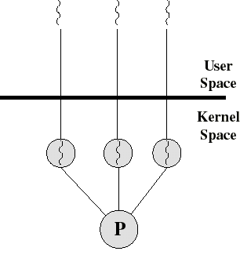
Kernel-Level Threads (KLT)
Ex: Windows NT, Windows 2000, OS/2
All thread management is done by kernel
No thread library; instead an API to the kernel thread facility
Kernel maintains context information for the process and the threads
Switching between threads requires the kernel
Kernel does Scheduling on a thread basis

Slide 12
Advantages and disadvantages of KLT
Advantages
The kernel can schedule multiple threads of the same process on multiple processors
Blocking at thread level, not process level
  If a thread blocks, the CPU can be assigned to another thread in the same process
Even the kernel routines can be multithreaded
Disadvantages
Thread switching always involves the kernel. This means 2 mode switches per thread switch
So it is slower compared to User Level Threads
  (But faster than a full process switch)

Slide 13
Multithreading Models
Many-to-One
One-to-One
Many-to-Many

Slide 14
Many-to-One
Many user-level threads mapped to single kernel thread
Examples:
  Solaris Green Threads
  GNU Portable Threads

Slide 15
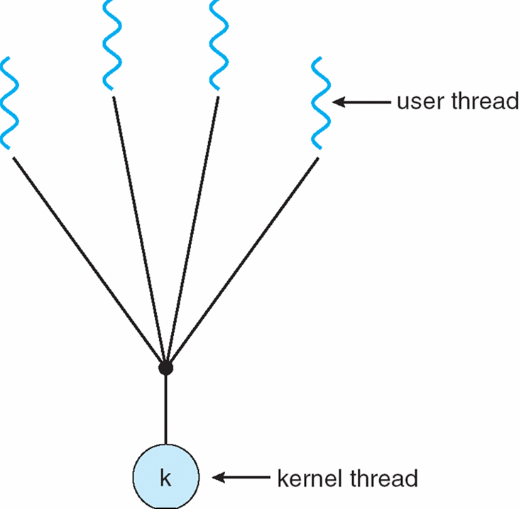
Many-to-One Model

Slide 16
One-to-One
Each user-level thread maps to kernel thread
Examples
  Windows NT/XP/2000
  Linux
  Solaris 9 and later

Slide 17
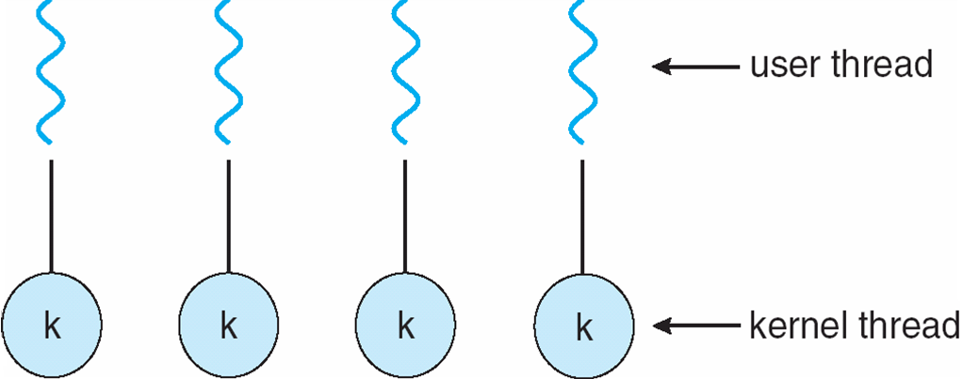
One-to-one Model

Slide 18
Many-to-Many Model
Allows many user level threads to be mapped to many kernel threads
Allows the operating system to create a sufficient number of kernel threads
Solaris prior to version 9
Windows NT/2000 with the ThreadFiber package

Slide 19

Many-to-Many Model

Slide 20
Thread state
Each thread has its own stack and local variables
Globals are shared.
File descriptors are shared. If one thread closes a file, all other threads can’t use
The file I/O operations block the calling thread.
Some other functions act on the whole process.
  For example, the exit() function operates terminates the entire and all associated threads.

Slide 21
The Pthreads API
The most important of thread APIs, in the Unix world, is the one developed by the group known as POSIX.
POSIX is a standard API supported
Portable across most UNIX platforms.
PTHREAD library contains implementation of POSIX standard
To link this library to your program use –lpthread
  gcc MyThreads.c -o MyThreadExecutable - lpthread

Slide 22
The Pthreads API
The subroutines which comprise the Pthreads API can be informally grouped into four major groups:
Thread management: Routines that work directly on threads - creating, detaching, joining, etc. They also include functions to set/query thread attributes (joinable, scheduling etc.)
Mutexes, Condition variables, Synchronization

Slide 23
Thread Creation
Initially, your main() program comprises a single, default thread. All other threads must be explicitly created by the programmer.
pthread_create creates a new thread and makes it executable. This routine can be called any number of times from anywhere within your code.

Slide 24
Thread Creation
pthread_create( pthread_t *threadid
,const pthread_attr_t *attr, void
*(*start_routine)(void *),void *arg);
  This routine creates a new thread and makes it executable.
  Thread stack is allocated and thread control block is created
  Once created, a thread may create other threads.
  Note that an "initial thread" exists by default and is the thread which runs main.
  Returns zero, if ok
  Returns Non-zero if error

Slide 25
Thread Creation
pthread_create( pthread_t *threadid
,const pthread_attr_t *attr, void
*(*start_routine)(void *),void *arg);
threadid
  The routine returns the new thread ID via the threadid
  The caller can use this thread ID to perform various operations
  This ID should be checked to ensure that the thread was successfully created.
attr
  used to set thread attributes.
  NULL for the default values.
start_routine
  The C routine that the thread will execute once it is created.
arg
  Arguments are passed to start_routine via arg.
  Arguments must be passed by reference as pointers
  These pointers must be cast as pointers of type void.

Slide 26
#include <pthread.h>
#include <stdio.h>
#define NUM_THREADS 5
void * PrintHello(void *threadid)
{ printf("\n%d: Hello World!\n", threadid);
pthread_exit(NULL);
}
int main()
{
pthread_t threads[NUM_THREADS];
int rc, t;
for(t=0;t < NUM_THREADS;t++)
{
printf("Creating thread %d\n", t);
rc = pthread_create(&threads[t], NULL, PrintHello, (void *)&t);
if (rc)
{
printf("ERROR; return code from pthread_create() is %d\n", rc);
exit(-1);
}
}
pthread_exit(NULL); }

Slide 27
In main: creating thread 0
In main: creating thread 1
Hello World! It's me, thread #0!
In main: creating thread 2
Hello World! It's me, thread #1!
Hello World! It's me, thread #2!
In main: creating thread 3
In main: creating thread 4
Hello World! It's me, thread #3!
Hello World! It's me, thread #4!

Slide 28
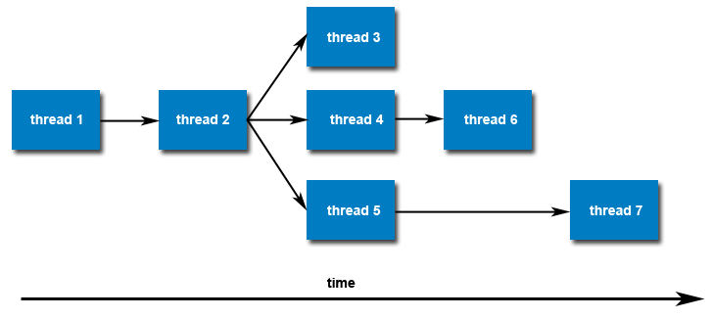
Thread Creation
Once created, threads are peers, and may create other threads. There is no implied hierarchy or dependency between threads.

Slide 29
Thread Termination
pthread_exit(status)
Several ways of termination:
  The thread returns from its starting routine (the main routine for the initial thread).
  The thread makes a call to the pthread_exit subroutine.
  The thread is canceled by another thread via the pthread_cancel routine.
  The entire process is terminated due to a call to the exit subroutines.

Slide 30
Thread Termination
The pthread_exit() routine does not close files; any files opened inside the thread will remain open after the thread is terminated.
If the "initial thread" exits with pthread_exit() instead of exit(), other threads will continue to execute.
The programmer may specify a termination status, which is stored as a void pointer for any thread that may join the calling thread i.e wait for this thread.

Slide 31
#include <pthread.h>
#include <stdio.h>
#define NUM_THREADS 5
void * PrintHello(void *threadid)
{ printf("\n%d: Hello World!\n", threadid);
pthread_exit(NULL);
}
int main()
{
pthread_t threads[NUM_THREADS];
int rc, t;
for(t=0;t < NUM_THREADS;t++)
{
printf("Creating thread %d\n", t);
rc = pthread_create(&threads[t], NULL, PrintHello, (void *)&t);
if (rc)
{
printf("ERROR; return code from pthread_create() is %d\n", rc);
exit(-1);
}
}
pthread_exit(NULL); }

